Slide 1
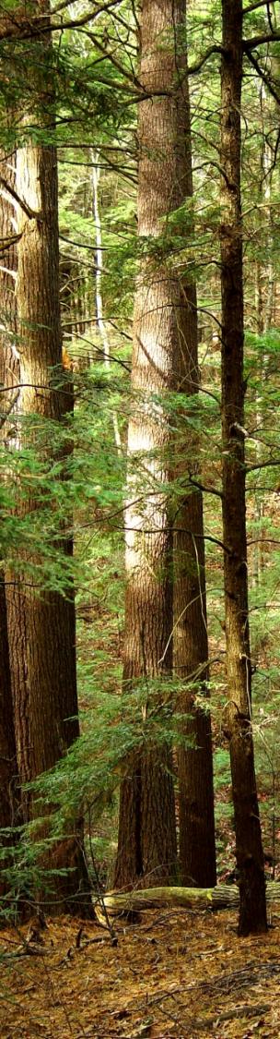
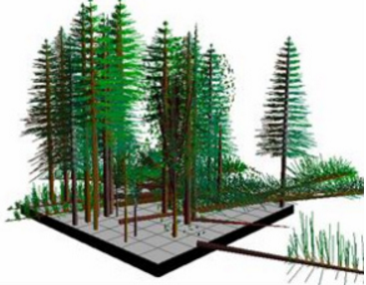

Modeling hemlock woolly adelgid risk and impacts of presalvage harvesting on carbon stocks in northern hemlock forests
Modeling the impacts of hemlock woolly adelgid infestation and presalvage harvesting on carbon stocks in northern hemlock forests
Jeffrey Krebs, Jen Pontius and Paul Schaberg
Mapping relative risk of HWA impacts on hemlock growth across the northeast
William Livingston, Jen Pontius,
Kara Costanza and Stacy Trosper

Slide 2
Hemlock Wooly Adelgid
Most of what we know about HWA impacts on eastern hemlock comes from studies in southern New England and the mid-Atlantic:
  Many infested trees die within 4-6 years but others persist in weakened state
  Extreme cold limits HWA populations
  Other causes of variable susceptibility are unclear
  Hemlock is typically replaced by black birch following widespread mortality

Slide 3
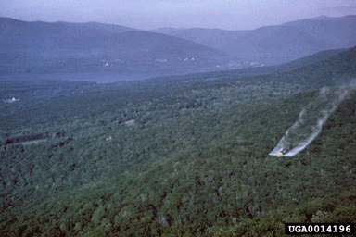





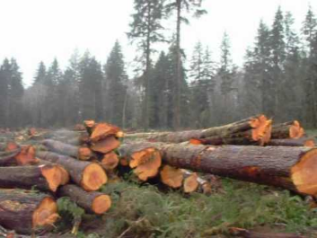
Management Options
Chemical Control Efforts:
Pesticides, Insecticidal Oils/Soaps are promising for valuable landscape trees but not feasible for larger stands.
Biological Control Efforts:
Natural predators have been imported from Asia but there is little evidence of HWA eradication in release areas
Successful biological controls must be targeted in key locations.
Preemptive and salvage Harvests:
Typically conducted to improve resistance or resilience, recoup potential financial losses, manage forest transitions

Slide 4
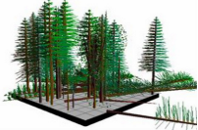
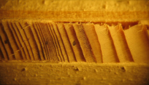
Research Goals
Hemlock Stand Dynamics
Simulate the potential impact of HWA infestation and preemptive harvesting on:
  species composition
  carbon dynamics
Hemlock Growth Response
Quantify the variable response of hemlock to HWA
Map relative susceptibility across the region

Slide 5
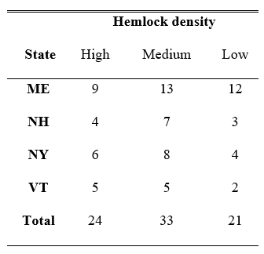
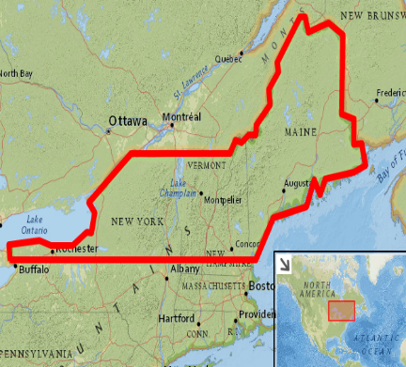
Hemlock Stand Dynamics: Methods
Using inventories of hemlock stands from the USFS Forest Inventory and Analysis (FIA) network we modeled stand dynamics, species composition and C storage over the next 150 years using the Forest Vegetation Simulator (FVS) for four HWA scenarios:
  No disturbance (control)
  HWA infestation
  Presalvage logging
  Presalvage logging plus HWA infestation

Slide 6
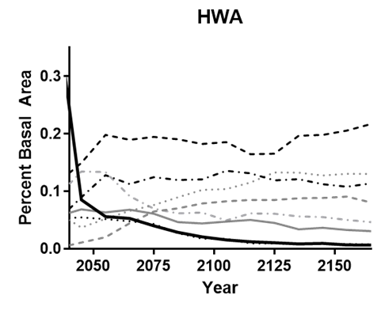
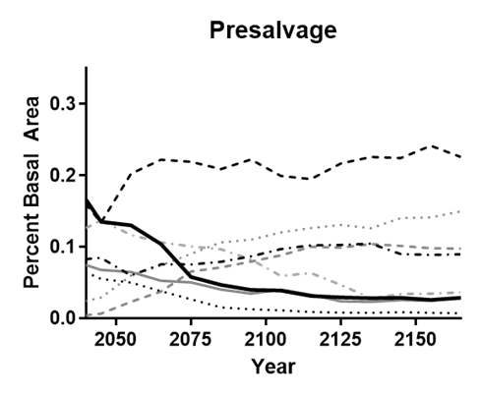
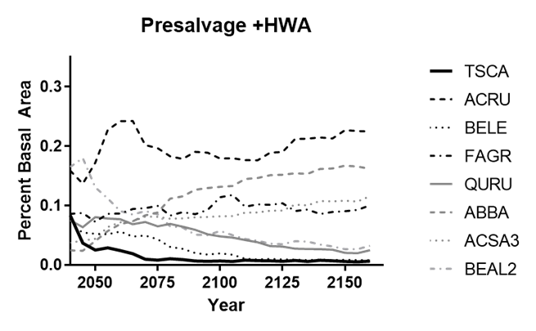
Hemlock Stand Dynamics: Results (Species composition)
Rates of change vary but consistently across all three scenarios:
      Hemlock decreases significantly
      Red maple dominates
      Balsam fir is the only conifer of note
Notes:
Short Term: HWA-induced mortality showed the highest total C storage due to regeneration and ingrowth of replacement species combined with retention of standing and downed dead wood
Long Term: The cumulative net C gain, was lower for the presalvage than HWA scenario,

Slide 7
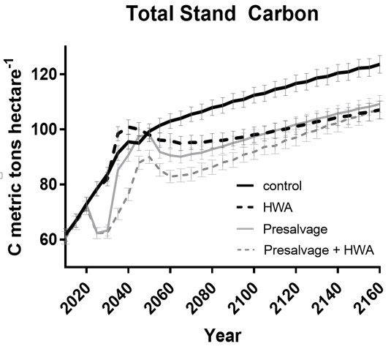
Hemlock Stand Dynamics: Results (Carbon Storage)
C continues to accrue in northern hemlock forests following HWA
All three HWA scenarios result in significantly lower total carbon storage than the control
Impacts to northeastern hemlock forests could result in a net loss of over 4 million metric tons of C over the next 150 years.
Notes:
Short Term: HWA-induced mortality showed the highest total C storage due to regeneration and ingrowth of replacement species combined with retention of standing and downed dead wood
Long Term: The cumulative net C gain, was lower for the presalvage than HWA scenario,

Slide 8
Hemlock Stand Dynamics: Results (Carbon Sequestration)
Short term increases in HWA C storage due to regeneration and ingrowth combined with retention of dead wood result in a higher cumulative net C gain for HWA over other scenarios
Notes:
The net cumulative change in C sequestered and stored in the short term (through year 2050) indicated that both the control and HWA treatments (both 32 net metric tons C ha⁻¹) were significantly higher than presalvage (29 net metric tons C ha⁻¹), which was in turn significantly higher than the presalvage (+HWA) scenario (24 net metric tons C ha⁻¹). This indicates that in the short-term, allowing HWA to play out in infested stands may be preferable to presalvage activities when maximizing short-term C sequestration and net C storage is a management objective, particularly in stands where infestation is imminent.

Slide 9
Hemlock Stand Dynamics: Conclusions
Allowing HWA to progress naturally through a stand may result in the least impact to net C storage.
The loss of a keystone species is likely to have other ecological consequences (particularly due to projected replacement by functionally distinct red maple)
This is similar to other studies that note the many ecological benefits derived from leaving forests alone when they are threatened by pest and pathogen outbreaks (e.g., Foster and Orwig 2006).
Notes:
while post disturbance regeneration may provide a boost to yearly rates of net productivity, long-term there is still a cumulative decrease in cumulative net C sequestration and storage that is likely to result from HWA infestation and associated presalvage harvests with a potential legacy that persists at least 150 years post disturbance.
This could also help maintain genetic pools within local hemlock populations, thereby increasing the chance that HWA-tolerant trees will survive, regenerate and spread (Foster and Orwig 2006).

Slide 10
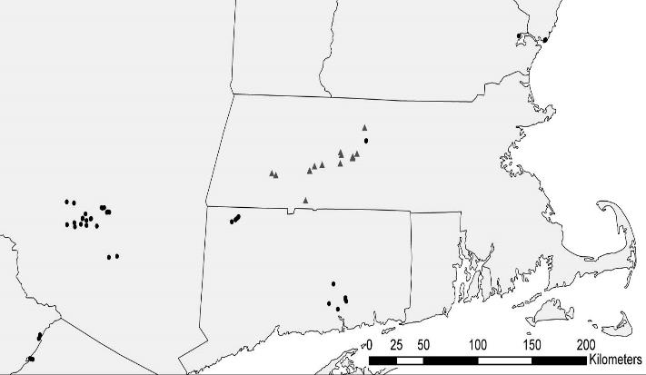
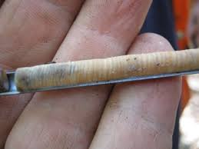
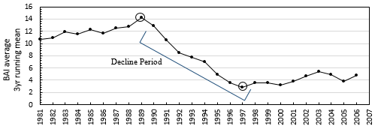
Hemlock Growth Response: Methods
Tree cores from 41 long-term HWA monitoring and 15 independent validation plots across the region were used to quantify growth response to HWA infestation
Site, stand and climate characteristics were used to model the probability of rapid decline following infestation
Key variables were used to map risk under 3 climate scenarios

Slide 11
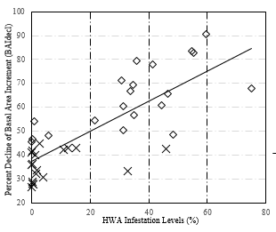

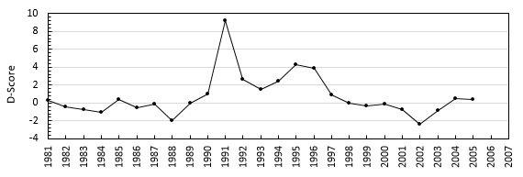
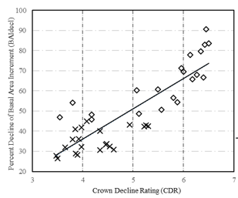
Hemlock Growth Response: Results
Decline events were noted in response to drought and HWA infestation
Changes in growth are a useful proxy for HWA infestation impacts

Slide 12
Hemlock Growth Response: Results
A Logit Regression was able to accurately differentiate stands with varying rates of HWA induced decline with 80% accuracy
Rapid decline was predicted at sites with:
    Warmer Minimum January Temperature
    Warmer summer hillshade positions (aspect)
    Steeper slopes (rapid drainage, shallow soils)

Slide 13
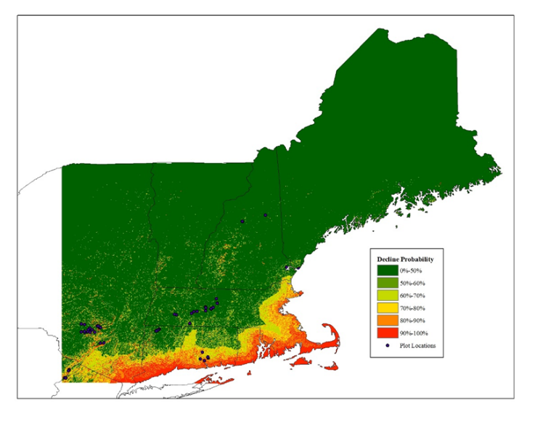
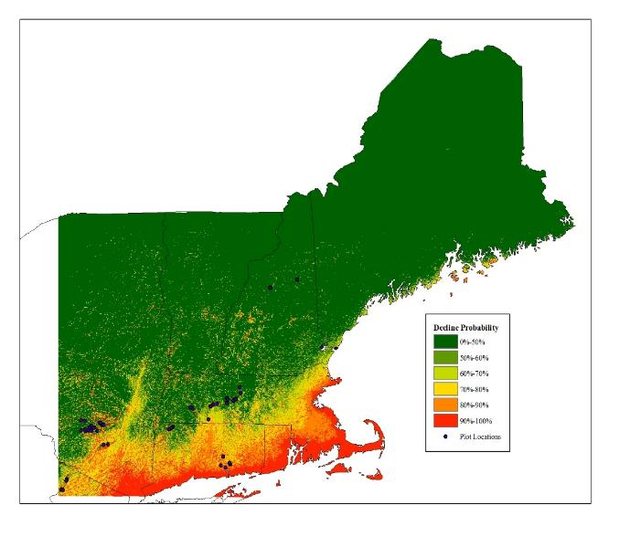
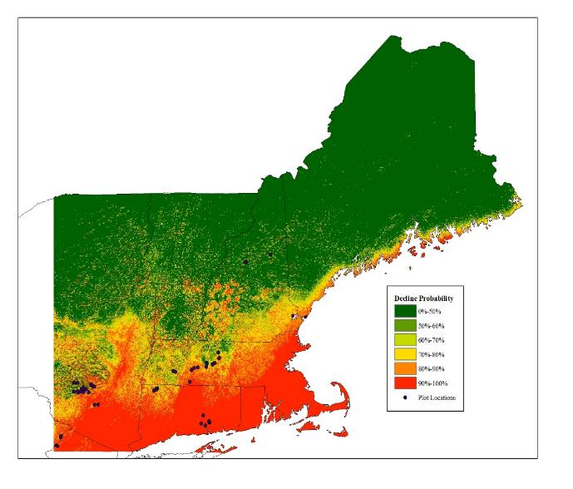
Hemlock Growth Response: Results
Projections across the landscape under 3 climate scenarios identify locations of relative susceptibility across the region.
Historical climate (1971-2000 normals)
Current climate (1981-2010 normals)
Projected climate (2ºC increase over current)

Slide 14
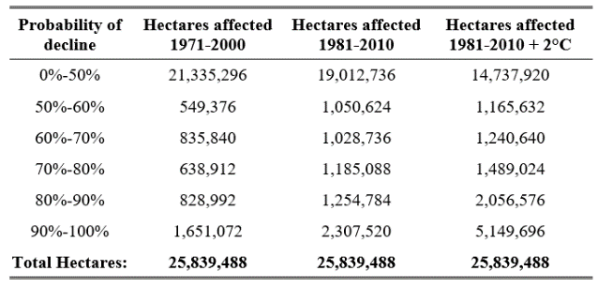
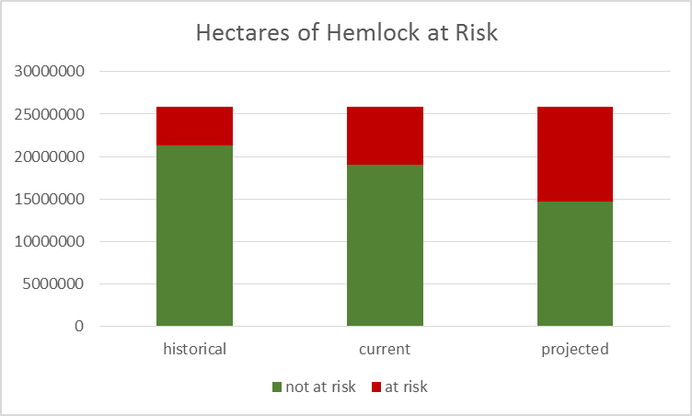
Hemlock Growth Response: Conclusions
The risk of rapid HWA induced decline can be predicted based on a suite of site and climate characteristics
Mapped across the landscape this indicates that rapid decline following HWA infestation is likely for:
  17% of hemlock historically
  26% of hemlock currently
  42% of hemlock under projected climate conditions

Slide 15
Take Home Message
Hemlock Woolly Adelgid will be moving into northern New England
Management activities should consider how to best sustain this critical resource
Targeting control efforts in stands likely to tolerate infestation
Minimizing impacts to ecological processes
Encouraging transition to functionally similar species

Slide 16
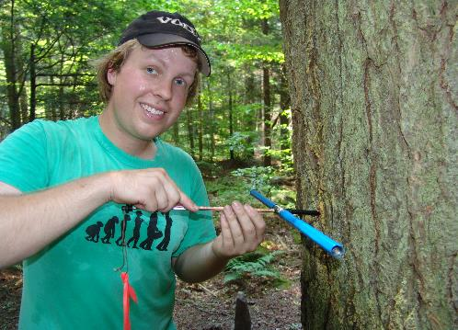
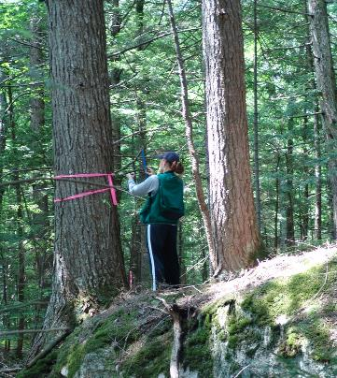
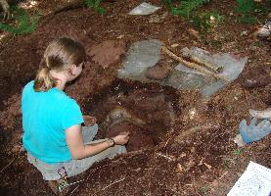
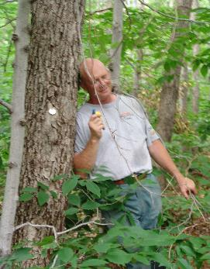
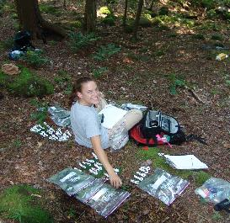
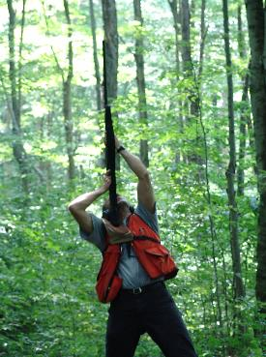



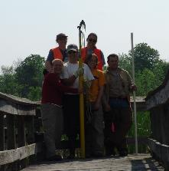
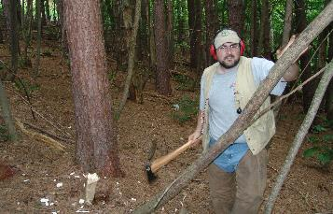


Many Thanks
Fearless
Field Crews
Generous
Granting Agencies

